Slide 1
Sales Analysis Dashboard

Slide 2
Introduction
The Sales Analysis Dashboard is a powerful tool designed to provide insights into sales performance, trends, and opportunities.
This Dashboard enables business to track key sales metrics, analyze customer behavior, and identify areas for improvement.
By leveraging data visualization and analytics, the Sales Analysis Dashboard helps businesses make data-drive decisions, optimize sales strategies, and drive revenue growth.

Slide 3
Methodology
The Sales Analysis Dashboard will be developed using a structured methodology to ensure the delivery of a comprehensive and effective dashboard. The methodology will consist of the following phases:
1. Requirement Gathering
2. Data collection and integration (e.g., sales report)
3. Data Analysis and Visualization
4. Dashboard Development
5. Testing and Validation
6. Deployment and Maintenance.

Slide 4
Requirement Analysis
Functional Requirements
Non-Functional Requirements
Data Integration: Integrate sales data from various sources(e.g., Sales reports)
Data Analysis: Analyze sales data to identify trends, patterns, and insights.
Data Visualization: Provide interactive and intuitive data visualizations (e.g., charts, graphs, tables).
Drill-Down Capability: Allow users to drill down into detailed data for future analysis.
Real-Time Updates: Provide real-time updates to ensure data accuracy and relevance.
User-Friendly Interface: Design an intuitive and user-friendly interface.
Performance: Ensure data security and integrity.
Security: Ensure data security and integrity.
Scalability: Design the dashboard to accommodate increasing amounts of data and user traffic.

Slide 5
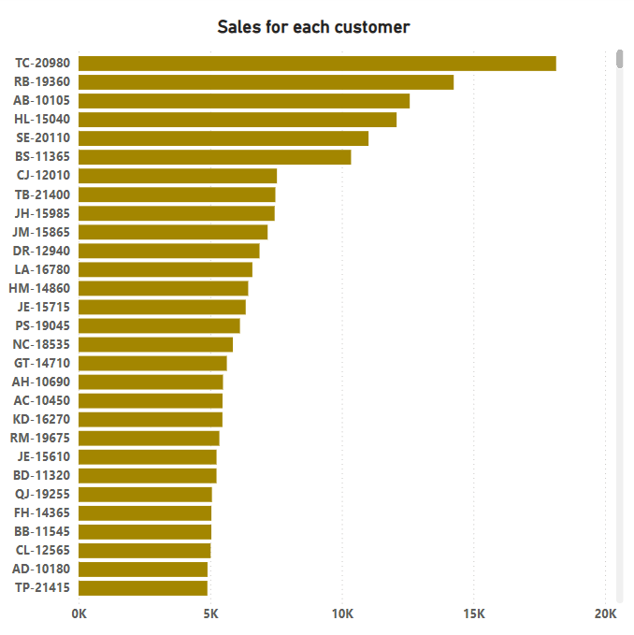
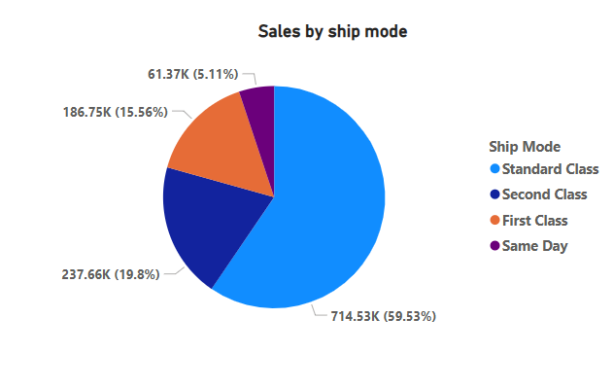

Slide 6
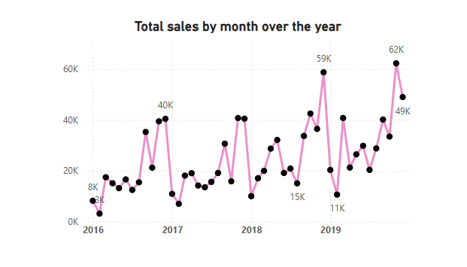
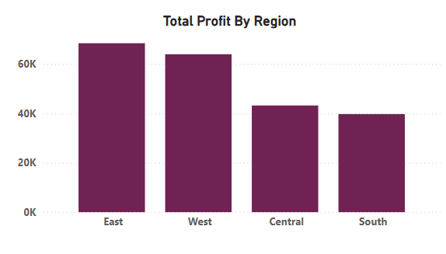

Slide 7
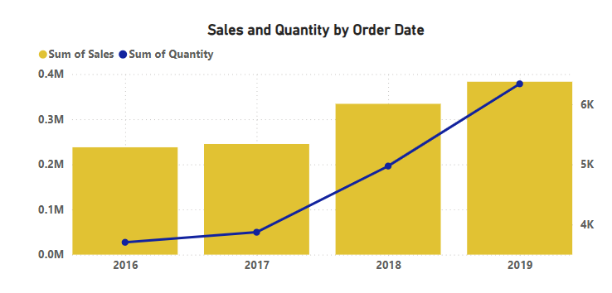
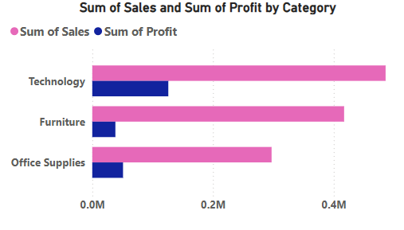

Slide 8
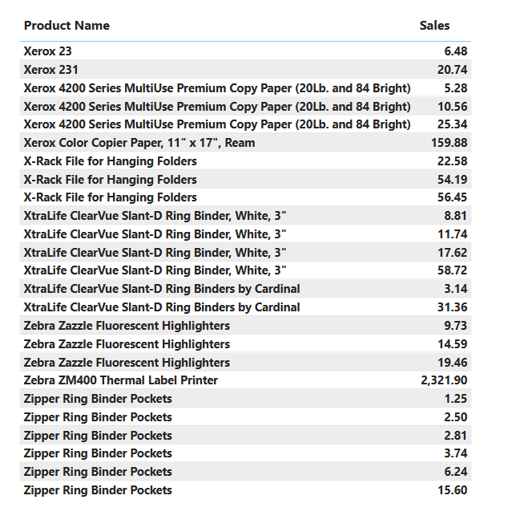
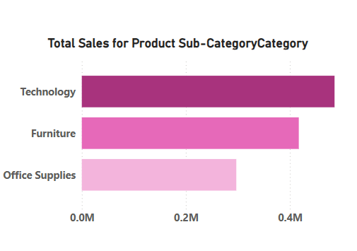

Slide 9
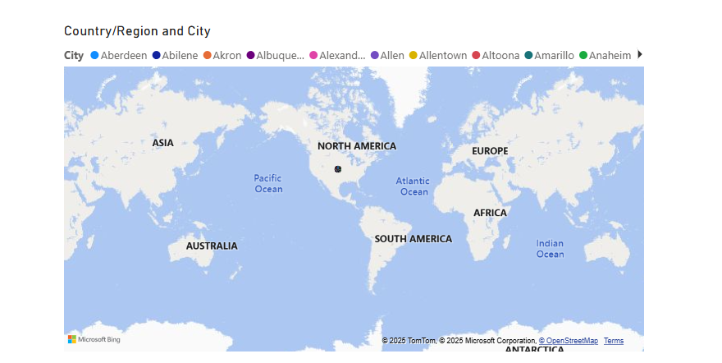
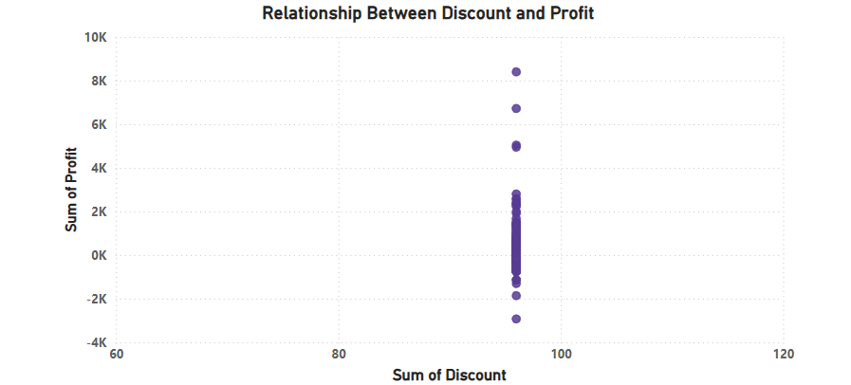

Slide 10
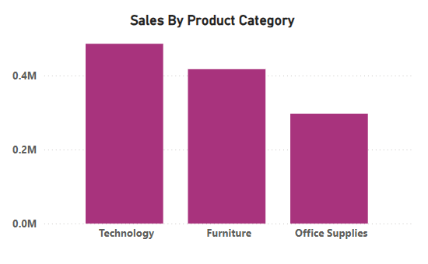
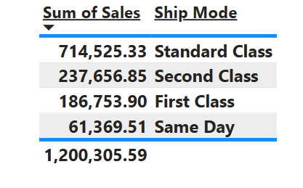

Slide 11
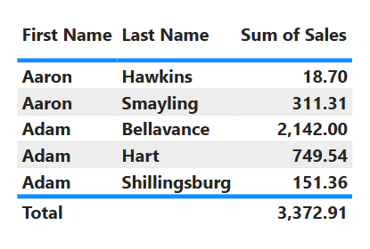
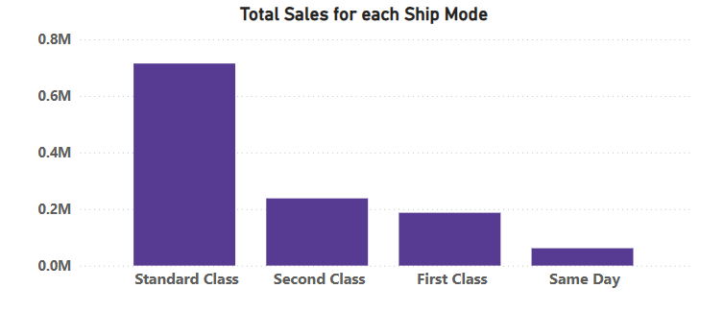

Slide 12
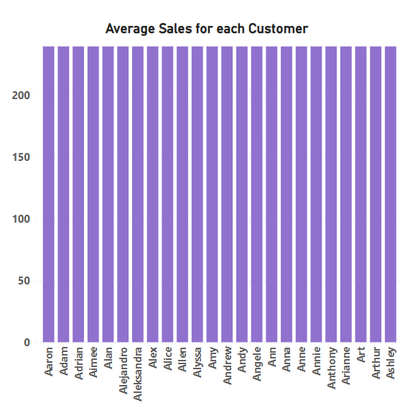
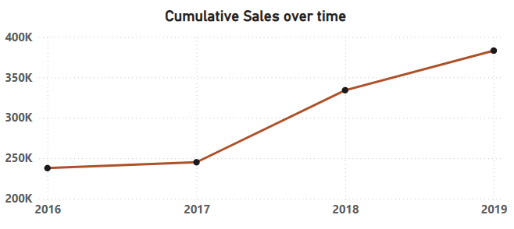

Slide 13
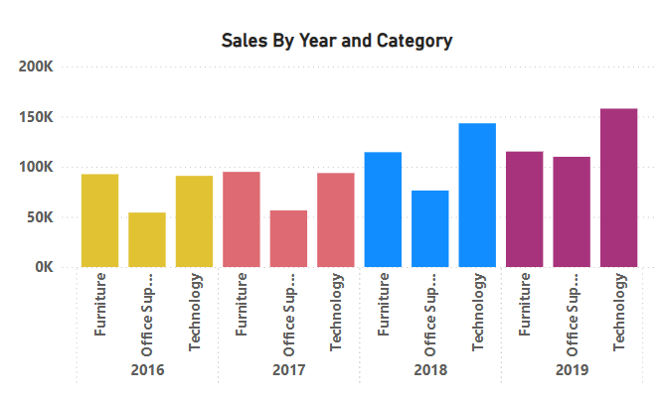
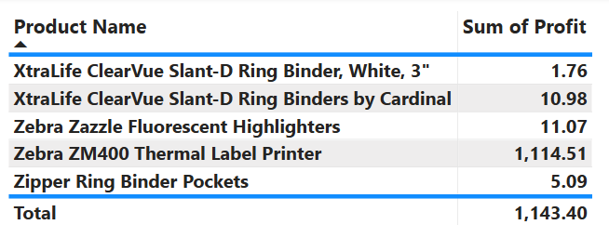

Slide 14
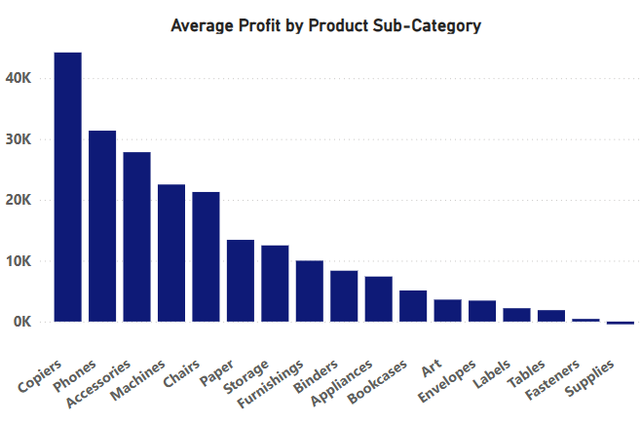
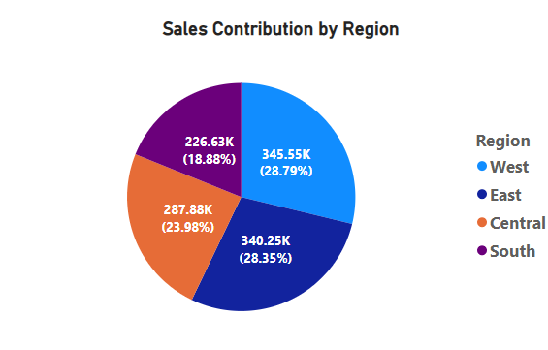

Slide 15
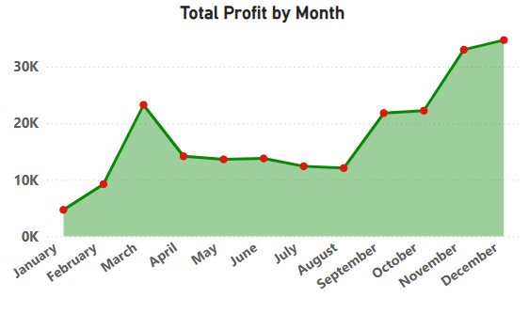
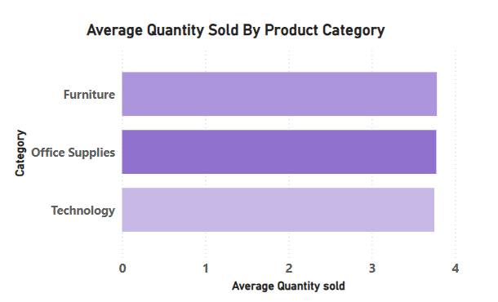

Slide 16
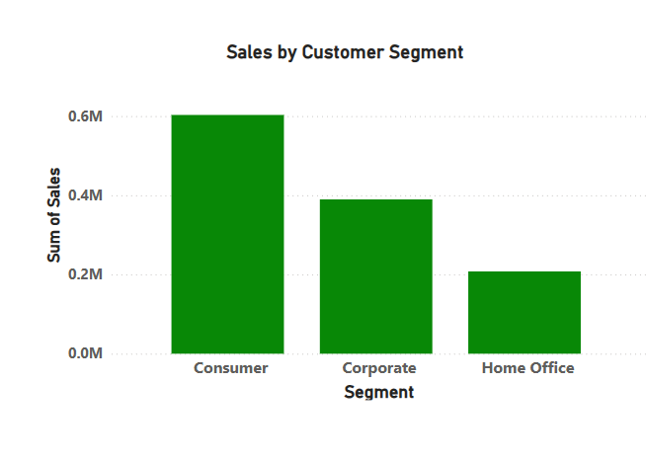
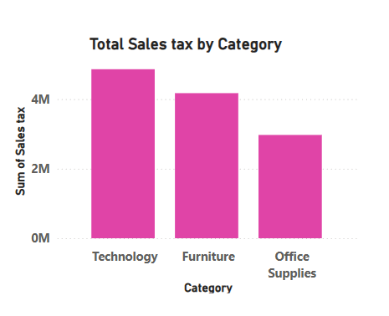

Slide 17
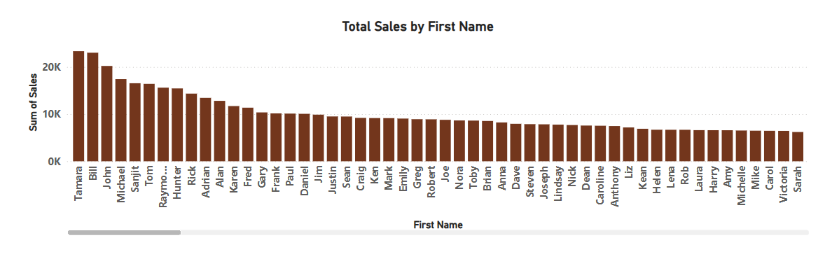
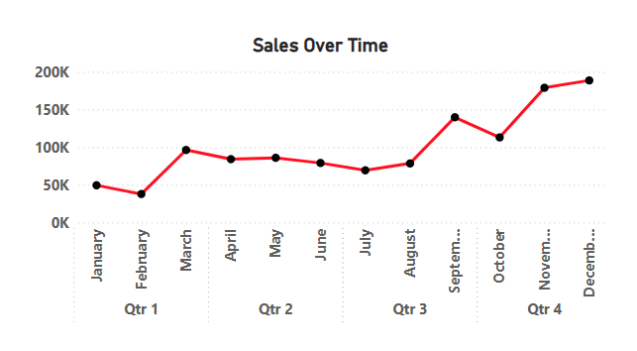

Slide 18
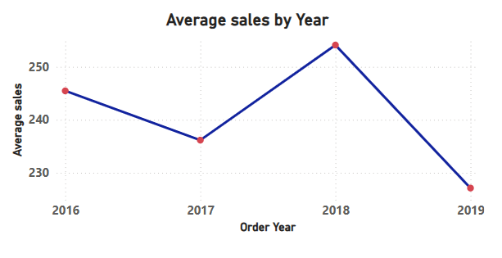
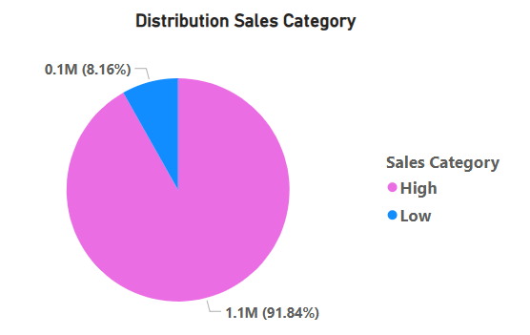

Slide 19
Conclusion:
The sales Analysis Dashboard is a powerful tool designed to provide insights into sales performance, trends, and opportunities.
By leveraging data visualization and analytics, the dashboard enables businesses to track key sales metrics, analyze customer behavior, and identify areas for improvement.
The Sales Analysis Dashboard is an essential tool for businesses looking to optimize their sales performance and drive growth.

